Slide 1


Biodiversity analysis: Bryce, Yosemite, Yellowstone and Great Smoky Mountains National Parks
Pedro Sánchez | Codecamy Project

Slide 2

Analysis of the diversity considering the conservation status and the park they’re observed
Pedro Sánchez | Codecamy Project
We have two different datasets to work with:
Species dataset
Observation dataset
With both datasets we will try to extract some useful information about the diversity of the species in all 4 parks.

Slide 3
Considerations of the project
Pedro Sánchez | Codecamy Project
Both datasets were provided
Analyse the data structure of our data
Analyse the missing data and trying to explain why is it missing
How to handle these missing values
Analyse the data in order to be aware of the biodiversity and the relationship with the variables we have measured.
Notes:
Es posible que se requiera más de una diapositiva

Slide 4
Question we would like to answer
Pedro Sánchez | Codecamy Project
Has any park specialized in any specific category of these species?
Is there any correlation between vascular and non vascular plants with the conservation status?
Is it more likely that one of the species has worse conservation status than others?

Slide 5
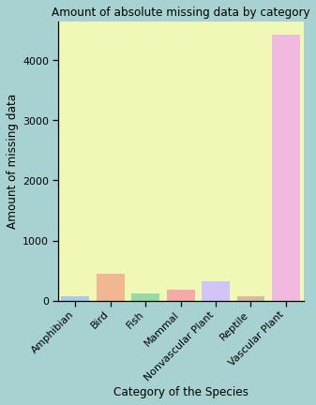
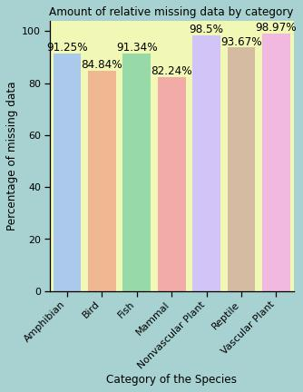
Treatment of missing data
Pedro Sánchez | Codecamy Project
Most of the missing values correspond to Vascular Plants.
If we analyse a bit better, we see that the missingness percentage in each category of the species doesn’t have a big difference.
Plants have a similar percentage of missing data, so does the rest of the animals.
We conclude that the data is structurally missing, species that doesn’t fall between the conservation status category, doesn’t have a value
Notes:
Es posible que se requiera más de una diapositiva

Slide 6
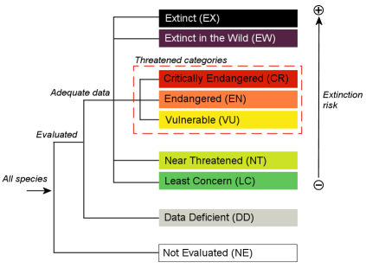
New values of the variable conversation status
Pedro Sánchez | Codecamy Project
New categories
Not Engangered
Species of Concern
Threatened
Endangered
In Recovery
Based in the image we are displayig in this screen, We categorize our data in the previous categories

Slide 7
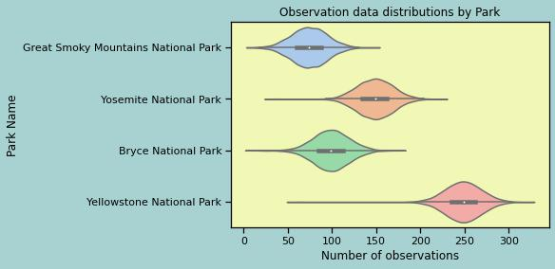
Park Observation Data Distribution
Pedro Sánchez | Codecamy Project

Slide 8
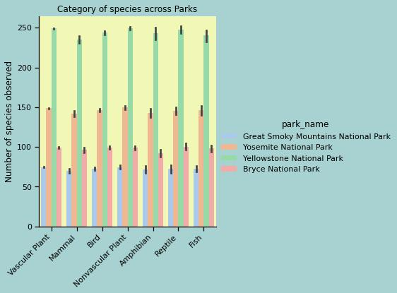
Has any park specialized in any specific category of these species?
Pedro Sánchez | Codecamy Project
In this chart we can see how the amount of species by each category doesn’t differ much from park to park.
We have run a chi squared test in order to be able to measure how much.
chi² test value: 0.0218 (p = 1.0)
Therefore, we can conclude that there’s no relation between variables.

Slide 9
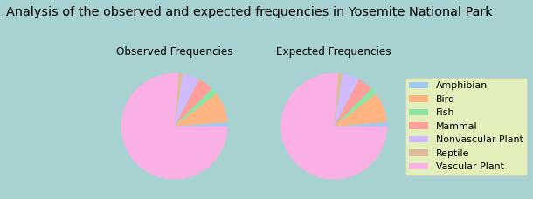

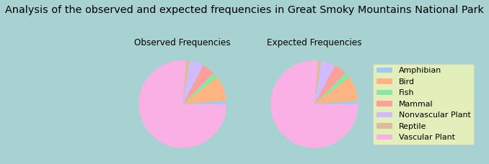
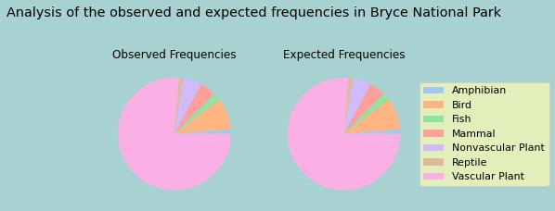
Comparison of observed and expected frequencies in each Park
Pedro Sánchez | Codecamy Project

Slide 10
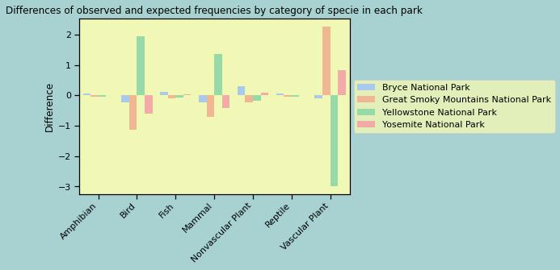
Differences between observed and expected frequencies
Pedro Sánchez | Codecamy Project
Notes:
Es posible que se requiera más de una diapositiva

Slide 11
Vascular and Non Vascular Plants, does it have any relation with conservation status?
Pedro Sánchez | Codecamy Project
 | Not Endangered | Species of Concern | Threatened | Endangered
Nonvascular Plant | 1312 | 20 | 0 | 0
Vascular Plant | 19350 | 172 | 8 | 4
Observed
 | Not Endangered | Species of Concern | Threatened | Endangered
Nonvascular Plant | 1318.98 | 12.26 | 0.51 | 0.26
Vascular Plant | 19343.02 | 179.74 | 7.49 | 3.74
Expected
chi² test value: 6.08 (p = 0.108). Small difference between categorical variables but not enough to tell the significance of this difference.

Slide 12
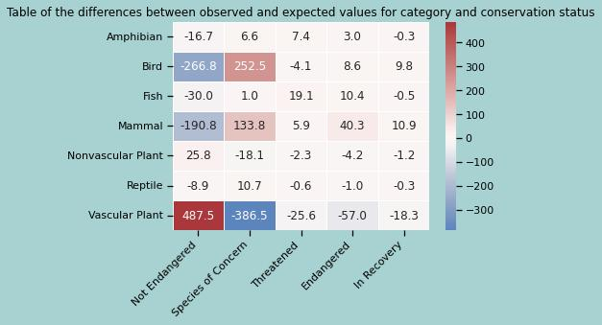
Is there a category of species more likely to have a worse condition than others?
Pedro Sánchez | Codecamy Project
chi² test value: 3130.218 (p < 0.0). There’s a correlation between both variables

Slide 13
Conclusions
Pedro Sánchez | Codecamy Project
After our analysis we can conclude the following:
The number of observations in each park is different, being Yellowstone National Park the park with the highest number of observations
There’s not a real difference between the number of observations of each specie in each park. The distribution of those species are similar within the parks.
The conservation status of Vascular and Non Vascular plants looks like it has a small difference, even though we are not able to confirm that, it would be interesting to increase the sample of data.
There’s definitely a correlation between the conservation status and the category of the scpecies. Is more likely that we observe a higher amount of Mammals and Birds in concern, at the contrary with Vascular plants, that it’s more likely to be not endangered.

